Slide 1
PHYS 111 Experiment 2
Kinematics of Linear Motion
Fall 2020

Slide 2
Objectives of Experiment 2
Verify the expressions for motion with uniform acceleration.
Determine the acceleration due to gravity at the earth surface.
Verify the expressions for projectile motion.
Notes:
Objectives

Slide 3
Kinematics of Motion
Describes the motion of objects regardless of the cause of this motion
Predicts parameters of motion:
  Displacement, Velocity and Acceleration
Notes:
We can use the second bullet point to initiate a discussion amongst the students: Can an instrument reduce systematic error? If so, in what cases? Can an instrument reduce random error? If so, when and how?

Slide 4


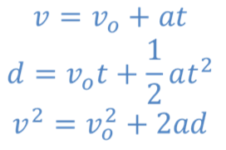
Kinematics of linear motion
Instantaneous velocity in x- direction:
Instantaneous acceleration in x- direction:
For a particle moving with a constant acceleration a:

Slide 5
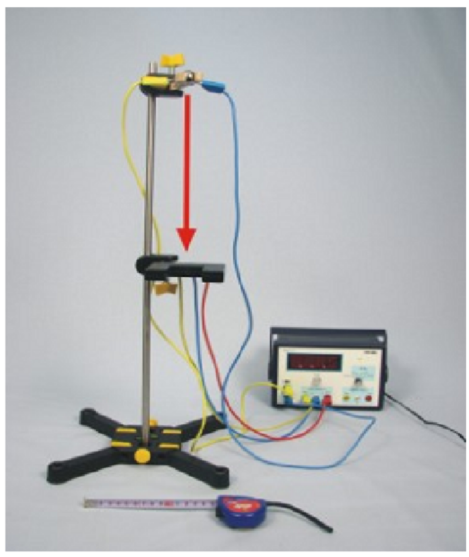


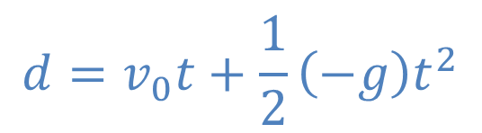
Verification of relations
1- Free fall metallic ball
g

Slide 6
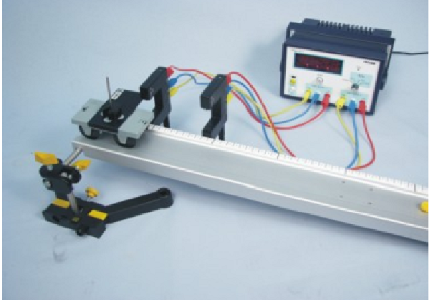
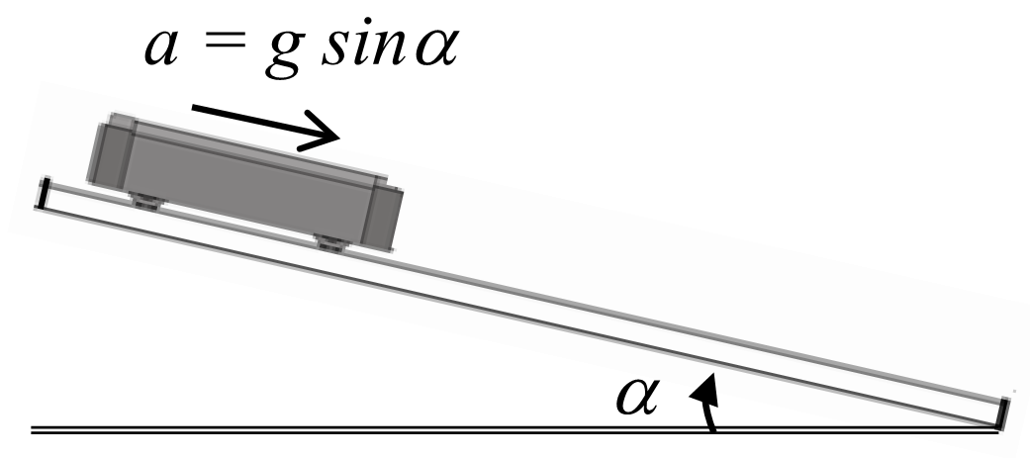



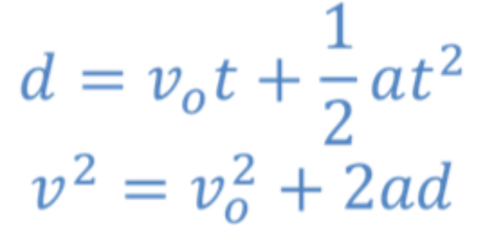
2- car moving down an inclined plane:

Slide 7
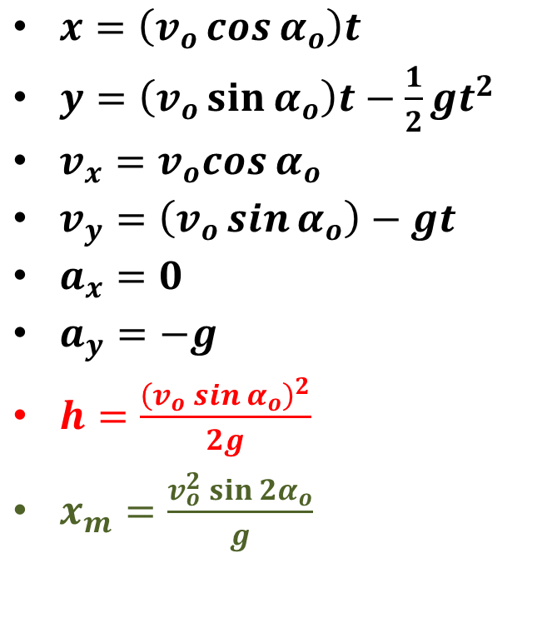
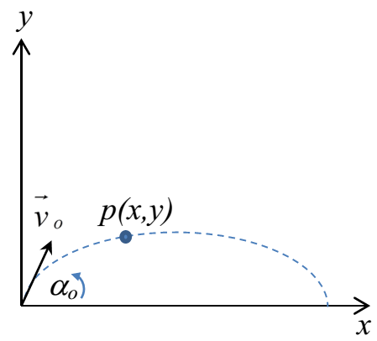


3- Kinematics of projectile motion:

Slide 8
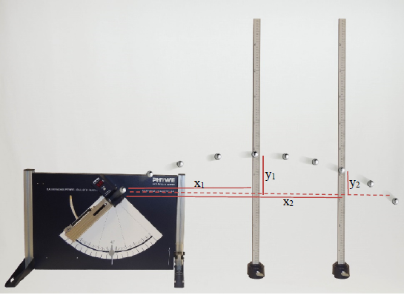

Slide 9
Objectives of Experiment 2
Investigate the parameters of motion (displacement, velocity and acceleration) in the case of linear motion with uniform acceleration.
Determine the gravitational acceleration using a free fall particle.
Investigate the parameters of projectile motion of a body.
Notes:
Objectives

